Slide 1
Automated Instructor
for CS101 Newbs
AutomaTA
Changyoon Lee, Donghoon Han, Hyoungwook Jin
with Alice Oh

Slide 2
Problem Statement
CS101 beginners ask many questions related to programming skills.
However, their questions contain not enough context
so they cannot find satisfactory answers from web searches
when self-studying.

Slide 3
Formative User Study
CS101 Goals
Computational Thinking
Programming Skills
Code
Debug
Syntax
Function Identification
Function usage
Program mechanism
Error message
Semantic error
What function do I use to open a file?
What is the return value of readline()?
Notes:
To further analyze the problem domain, we conducted a formative user study before the midterm pitch.
Most of the questions asked by the students were in the function identification and function usage category.

Slide 4



Existing Solutions
Response Speed
automaTA
Teaching Assistant
Answer Relevance
Notes:
We compared the existing solutions in terms of response speed and answer relevance.
AutomaTA aims to improve them by providing both fast response speed and high relevance.

Slide 5
Solution
To build a system which can suggest relevant functions immediately by interpreting the students’ query and code.
Notes:
Based on our findings, we built a system which can suggest relevant functions immediately by interpreting the students’ context, so that self-studying students can search relevant functions quickly

Slide 6



Design Goals
1. Reduce
response latency by
learning from data
2. Provide
task-relevant answers with
peer code examples
3. Handle
sloppy questions using
students’ context
Notes:
We have three design goals to meet. to ~~ , to provide ~~ and to hand ~~

Slide 7
System Workflow
Update Frequency
User Query, User Code
Function-related Question
Satisfied
User gets a useful answer! :D
Context Dependent Query-Function
Graph
(CDQF graph)
Update
Query & Answer
Unsatisfied
Human TA
Notes:
Let’s walk through our system.
The Context Dependent Query Function graph takes user query and code as input, and outputs top three relevant functions
If the user is satisfied with the function suggested, the graph updates the match frequency between the keywords and the function, so that subsequent questions can be better answered.
However, if the user is not satisfied with the answer, the query is handed over to human TA.
Then the TA’s answer and the query are used to update our graph.

Slide 8
Context Dependent Query Function Graph
Context Dependent Query Function Graph
hubo
left
find
location
...
1
9
2
1
Query keywords
8
turn_left()
pick_beeper()
map()
“How do I make
hubo turn left?”
turn_left()
User code,
Peer code
3
Code Example
hubo.turn_left()
hubo.move()
5
Notes:
Let’s see how CDQF graph works.
When an user gives a query, the graph calculates the score of each function based on the query, and the function used in user code and peer code.
Here, turn_left function got the highest score 9, and is suggested as the most relevant function to the question with a code example from peer codes.

Slide 9
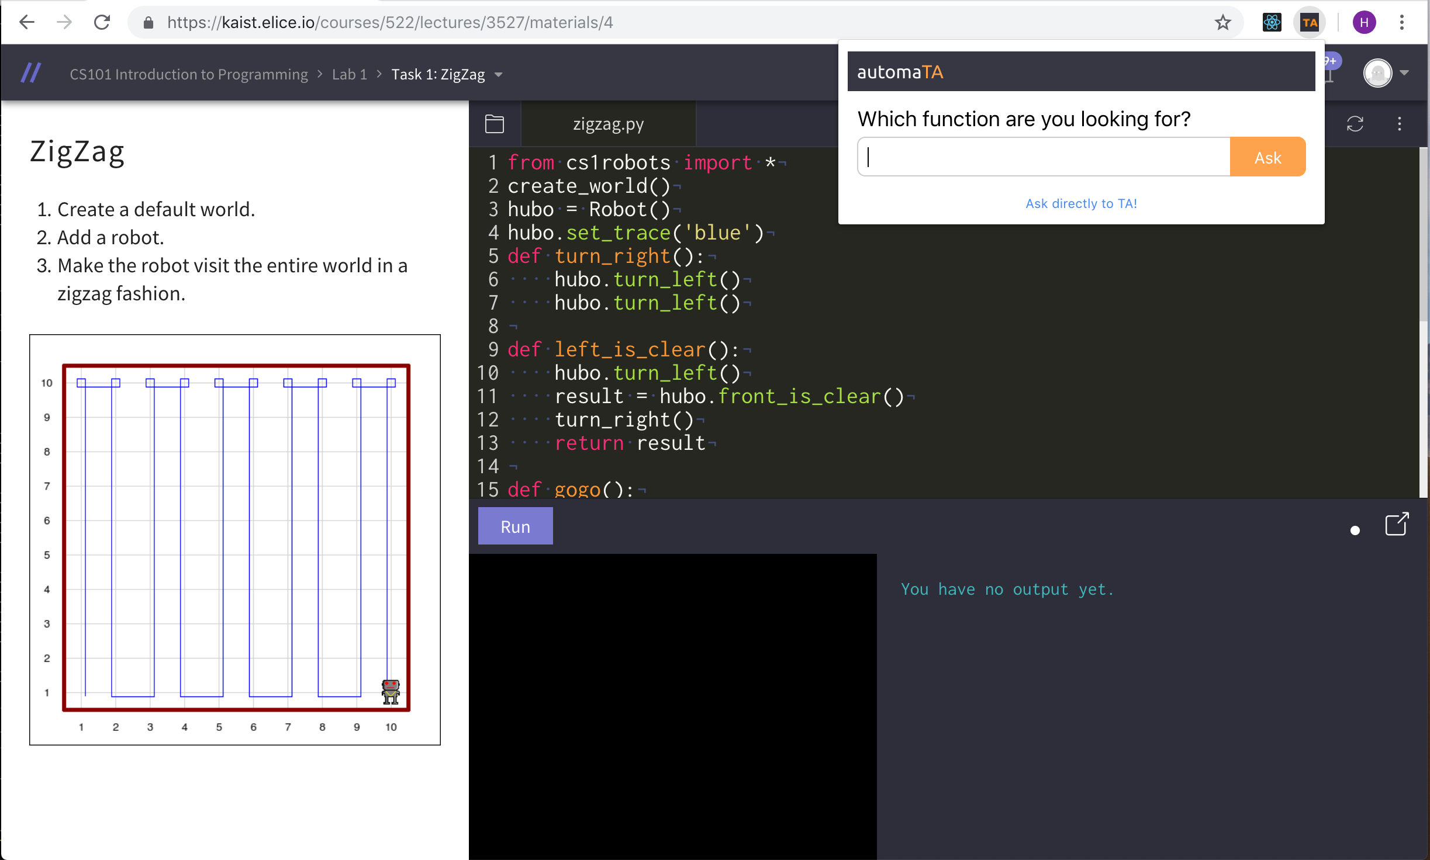
System Description
Notes:
Instead of building a platform, we decided to build a Chrome extension which adds to the rich features built in elice.io, and focus on the function suggestion feature instead.

Slide 10
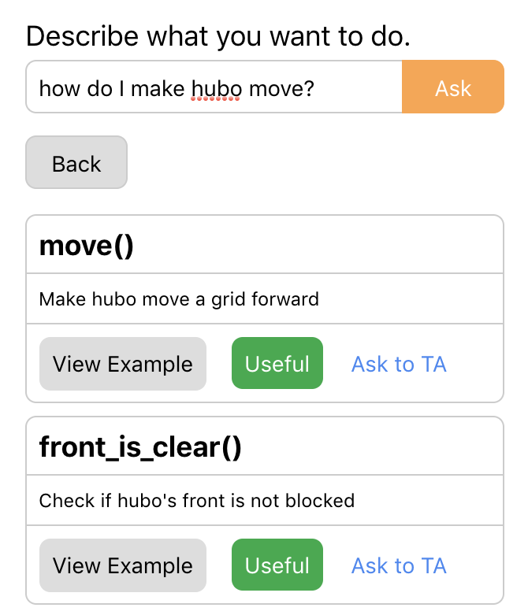
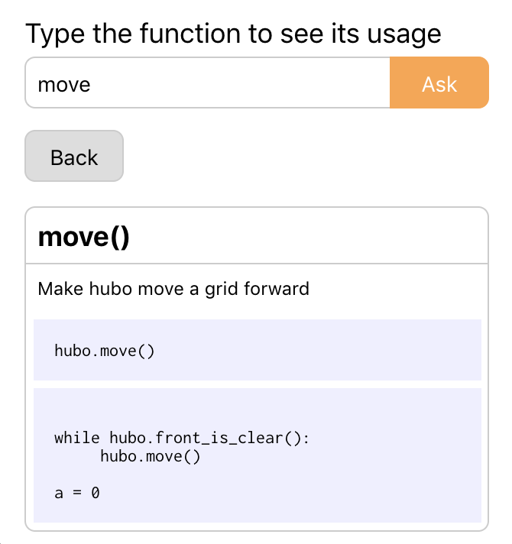
System Description
Function Suggestion
Function dictionary
Task-relevant example
Simple Explanation
Document example
User’s rating
(used for training)
Task-relevant example
Notes:
Our system provides two function-related features.
The function suggestion feature suggests top three relevant functions to the user’s question.
“View Example” button shows the examples of how each suggested function is used in peer codes.
Clicking useful button updates our CDQF graph.
The function dictionary also provides function description and code example.

Slide 11
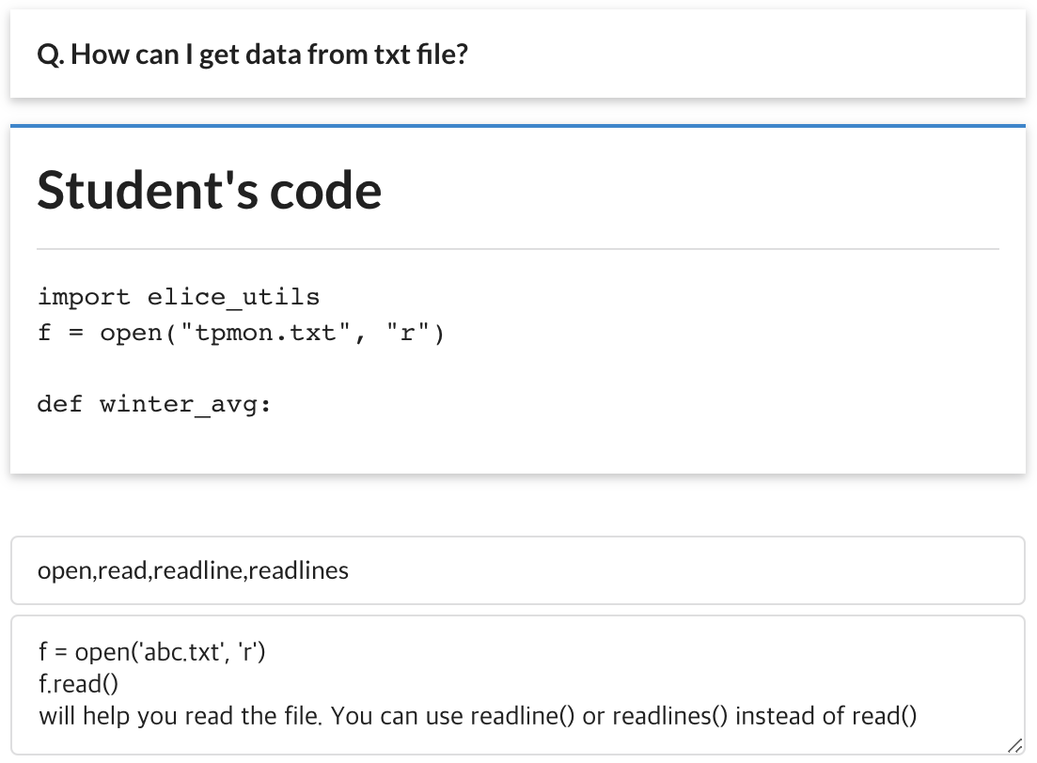
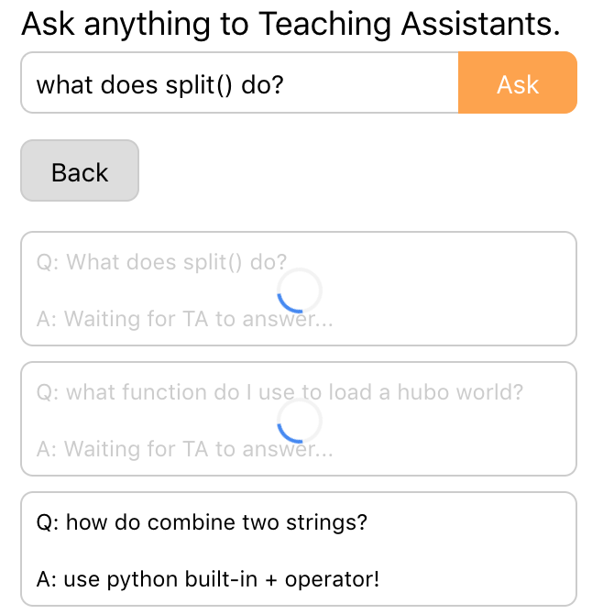
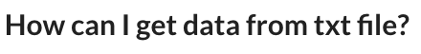
System Description
Answer by TA
Ask to TA
Function Suggestion
(used for training)
Explanation by TA
Notes:
The user can ask the TA directly too.
The user’s question and code are sent to the TA who answers the question with function suggestions and explanation.

Slide 12
Evaluation
1. Purpose
To test automaTA system and understand its strengths and weaknesses.
2. Setting
Nov. 26, 9pm to 10pm, N1-102
3. Participants
6 programming beginners, recruited with advertisement on ara
4. Process
The participants were assigned to different groups, with different task order and system usage order to reduce learning effect between tasks.
Solve a programming task using either Google or automaTA
Solve the other task using the system the participant did not use in 1
Take a survey on the experience
5. Training data
StackOverflow, Experiment, CS101 TA’s experience, CS101 document
6. Analysis
Quantitative and Qualitative analysis of survey data and system usage
Notes:
We did user study to evaluate automaTA system with 6 CS beginners.
Participants were assigned to different groups with different task and system usage order.

Slide 13
Function Suggestion
Relevance
2.8/5
Did function suggested by automaTA answer your question well?
“
I thought it was quite convenient,
but it was not easy to find the relevant function that I wanted.
”
Let’s train Context Dependent Query Function graph more!
Notes:
For quantitative analysis, we used 5 point likert scale for each question. Our system earned 2.8 points for giving relevant function suggestions. One of the participants felt that the function suggestion feature was convenient, but our system did not provide the function the user wanted. To expand the function coverage, we trained our CDQF graph after the user study.

Slide 14
Function Dictionary
Usability
2.0/5
Was the function dictionary convenient to use?
“
X 3
How do I search for a function
when I don’t even know the name of the function?
”
Let’s integrate two different search engines for our target user!
Notes:
For the function dictionary feature, our system earned low usability score. Many participants could not use the feature well because it requires them to type the exact function name. We removed this constraint by integrating function dictionary and function suggestion feature. The users can now use both features on the same search bar interface.

Slide 15
Human TA
Satisfaction
5.0/5
Was the answer provided useful?
“
This feature is most useful for python beginners
as they can freely ask questions
”
The high quality answers provided by the TA
can be used to train the Context Dependent Query Function Graph.
Notes:
All participants were satisfied with the answer given by human TAs. One of our ground truths was human TA can provide the most relevant and useful answers among other existing solutions. This result confirms our assumption and validates our approach to use human TA’s answer for training our CDQF graph.

Slide 16
Overall
Usability
Satisfaction
Retention
3.4/5
4.0/5
3.4/5
“
Once I get well-acquainted with the system,
the function dictionary and suggestion will help a lot.
”
“
When more function explanations and alarm are added,
automaTA will be very helpful.
”
Notes:
These are the overall scores for our system. There were usability issues like absence of alarm notification, etc., but people liked our approach which provides answers with relevant code examples immediately. When asked if they would like to use our system again later, more than half of the participants were positive.
Participants thought our system will improve once it supports more functions. Thus, we added all the functions used in CS101 to the best of our knowledge.

Slide 17
Compare to Existing Solutions
Response Speed
AutomaTA
Automated answer from CDQF
graph
Teaching Assistant
Relevance
Example from Peer Code
Notes:
We compared our result to existing solutions like Google search and human TAs. We provide more relevant answers than Google search by providing example code from peers who completed same programming task. Our system can respond to students’ questions quicker than human TAs can with the help of CDQF graph and the quality of answer gets better as more data accumulate.

Slide 18
Live Demo
Notes:
Now, we will show you how our system works. We will try a set of queries and how answers change depending on programming task and user code.

Slide 19
Any Questions?

Slide 20
Function Dictionary
Useful
Explanation
4.0/5
Was the explanation provided by automaTA useful?
3.5/5
Was automaTA more helpful than Google search?
Examples from peer code & simpler function description work!
Notes:
Meanwhile, we got positive result for showing function usage examples from peer codes. Most of the participants felt the examples given by our system were highly useful for their programming task, which could not be achieved by Google search. Examples from peer code & simpler function description seem to work.

Slide 21
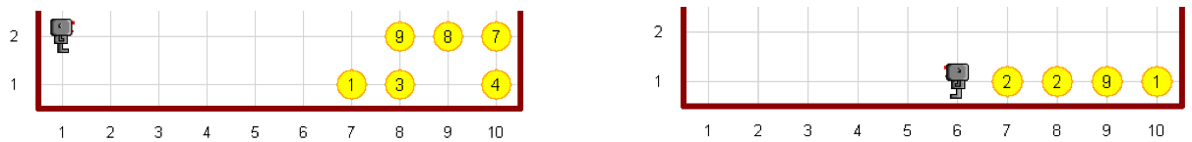

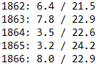
Tasks
We tried to reduce learning effect between tasks.
Add
move(), turn_left(), pick_beeper(), on_beeper(), drop_beeper(), front_is_clear()
Temperature
open(), close(), readlines(), write(), split(), strip(), float(), str(), join()
Notes:
We assigned participants two programming task which use different sets of functions to reduce learning effect when they do the second task.
The first task uses hubo-related functions and the second task uses file and string-related functions.

Slide 22
Context Dependent Query Function Graph
Exact match
(hubo, pick, beeper) → pick_beeper()
hubo
left
find
location
...
1
9
2
1
Query keywords
8
turn_left()
pick_beeper()
map()
“How does hubo
pick beeper?”
pick_beeper()
User code,
Peer code
3
Code Example
if hubo.on_beeper():
hubo.pick_beeper()
5
Notes:
However, our graph does not consider the relationship between keywords in the query, so we added exact match feature.
If the same keyword set already has a corresponding function in the database, that function is suggested first.
Here, the keyword set “hubo, pick, beeper” was already matched with pick_beeper(), so pick_beeper is suggested even though it has a lower CDQF score.

Slide 23
Scenario
task dependent answers
user code dependent answer
coverage of the context function graph

Slide 24
We cover all the functions used in CS101 to the best of our knowledge.
Relevance : Let’s see..
Speed : Sorry, we weren’t able to prove it due to limit of resources.

